Slide 1
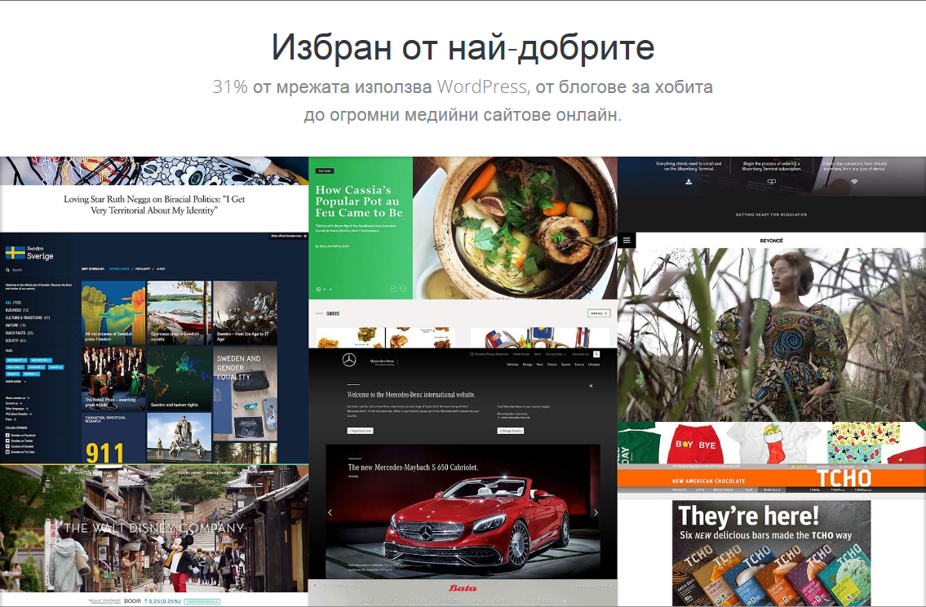

Slide 2
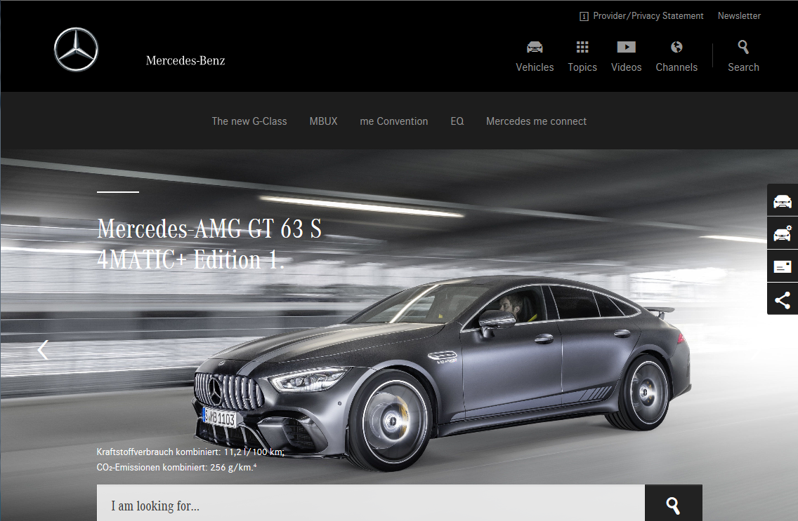
Защо WordPress?
Защо WordPress?
Най-широко използваният Self-Hosted софтуер към настоящия момент. Open-Source Проект, лицензиран съгласно GPL.
Изграден въз основа MySQL База-данни и Програмен език PHP.
Най-широко използваният Self-Hosted софтуер към настоящия момент. Open-Source Проект, лицензиран съгласно GPL.
Изграден въз основа MySQL База-данни и Програмен език PHP.
Какво целим?

Slide 3
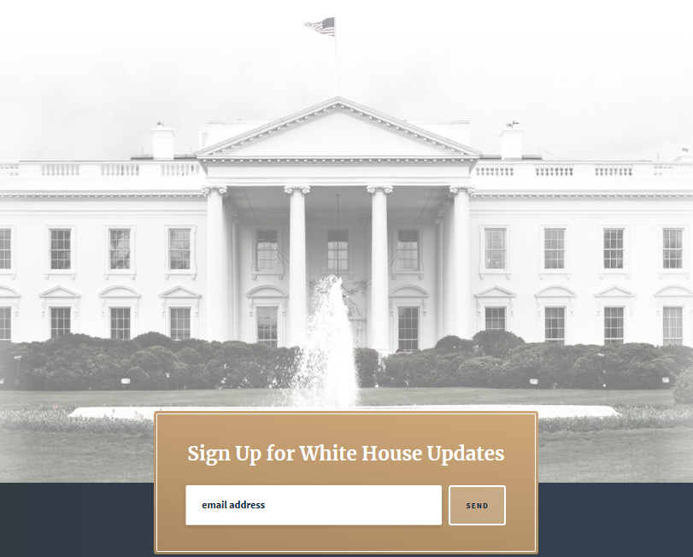

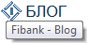
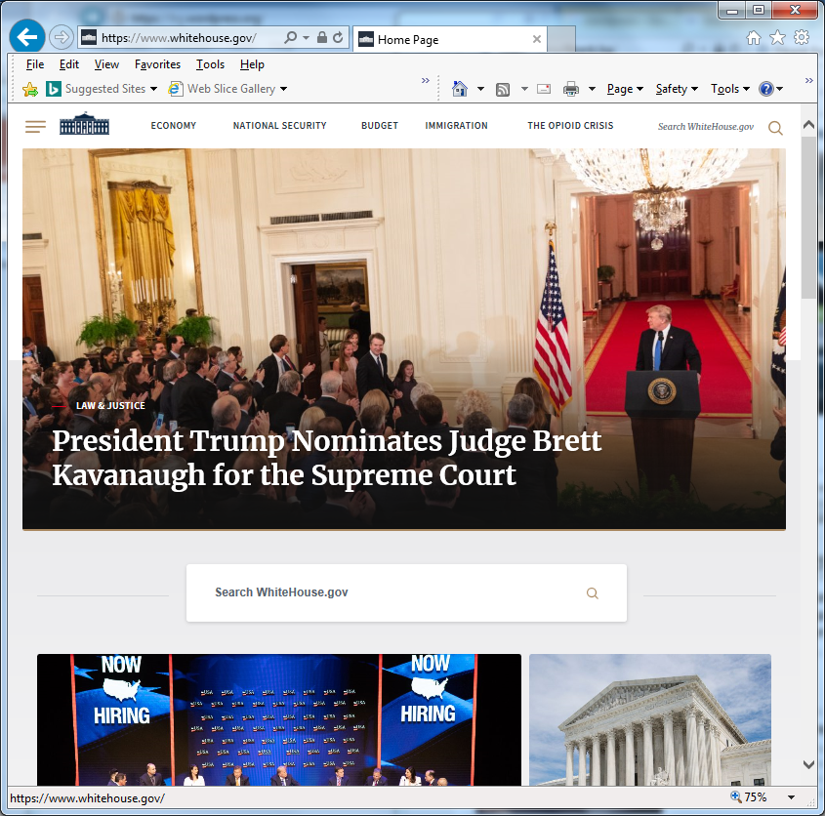
Знакови WordPress Потребители

Slide 4
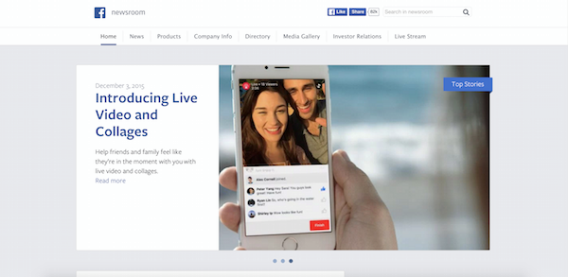
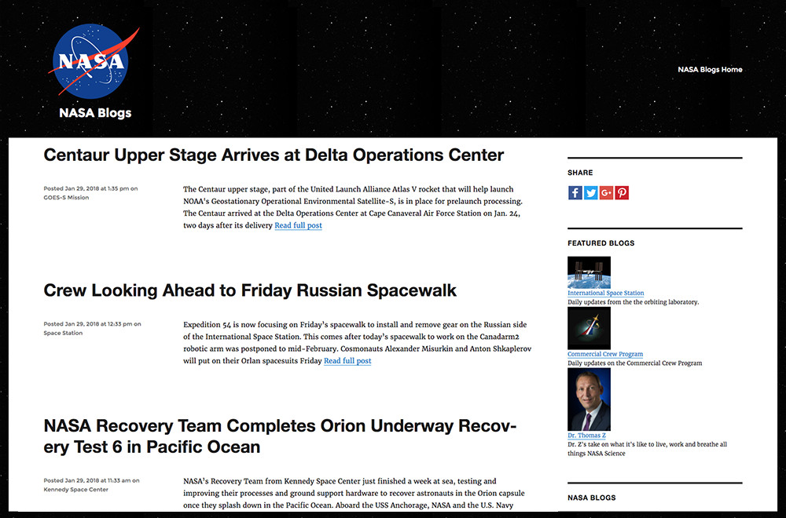
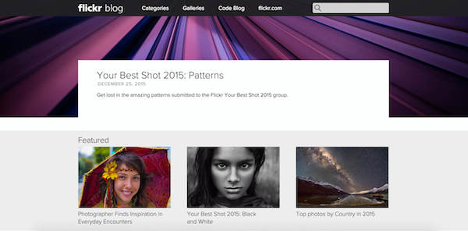
Други известни ползватели
Facebook Newsroom: .
Nasa:
Flickr Blog:
Microsoft News:

Slide 5
Features
Features
I. Common Features
1. Simplicity
2. Flexibility
3. Publish with Ease
4. Publishing Tools
5. User Management
6. Media Management
7. Full Standards Compliance
8. Easy Theme System
9. Extend with Plugins
10. Built-in Comments
11. Search Engine Optimized
12. Multilingual
13. Easy Installation and Upgrades
14. Importers
15. Own Your Data
16. Freedom
17. Community
18. Contribute
II. Developer Features
1. Plugin System
2. Theme System
3. Application Framework
4. Custom Content Types
5. The Latest Libraries

Slide 6
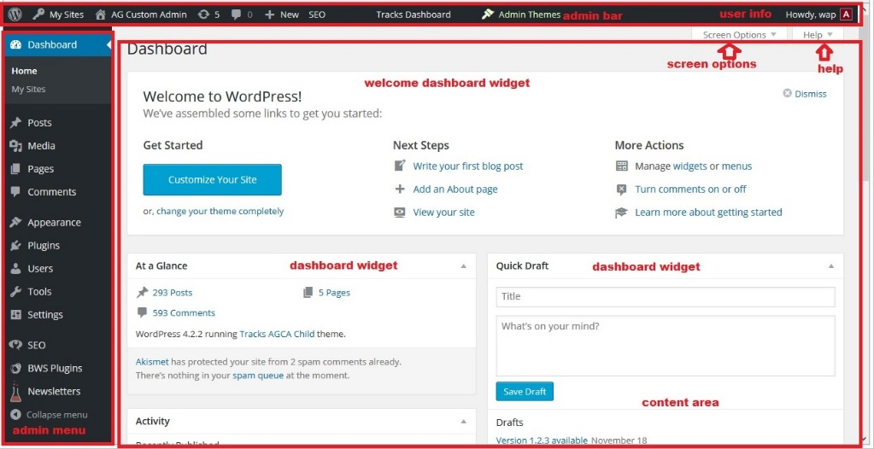
What is WordPress Admin Panel?
This is the place where you can do all
WordPress CMS management.
It is accessible only by authenticated users.
Admin Menu: is main navigation in the admin panel. Choose a menu item or submenu item to navigate to specific page
Admin Bar: is WordPress bar on top, and can contain some useful information and links. It shows for authenticated users only.
User Info: shows information about currently logged in user on admin bar. It’s located on the top right. On mouseover, it shows some more information about user’s profile and the button for logging out.
Content Area: is the central part of the WordPress admin panel where almost all data is shown. Different pages have different content, but top admin bar and left navigations are almost always the same.
Screen Options: are giving some additional options to hide/show some elements on pages. If you can’t find something on a page, try going here first to see if that element is hidden in the view.
Help: gives some useful links to WordPress help pages.
Dashboard Widgets: content on the dashboard pages is structured into Dashboard widgets. This way it’s very handy to move the content around or to show only the content that you actually need.
Welcome WordPress Dashboard Widget: shows some useful information for those who use WordPress for the first time. You can easily hide it by clicking on Dismiss.

Slide 7
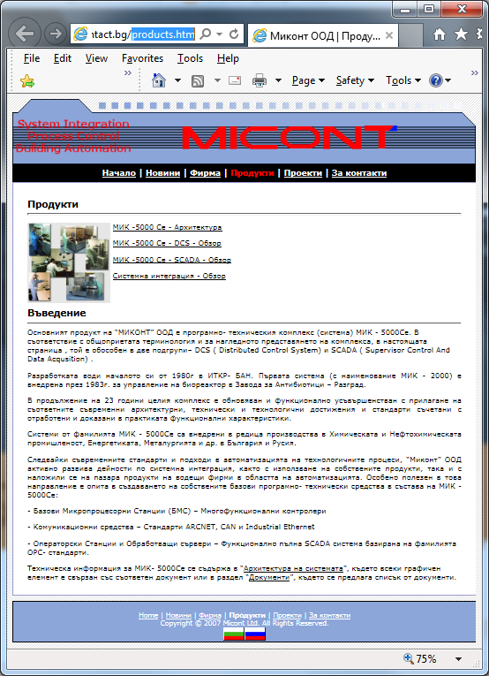
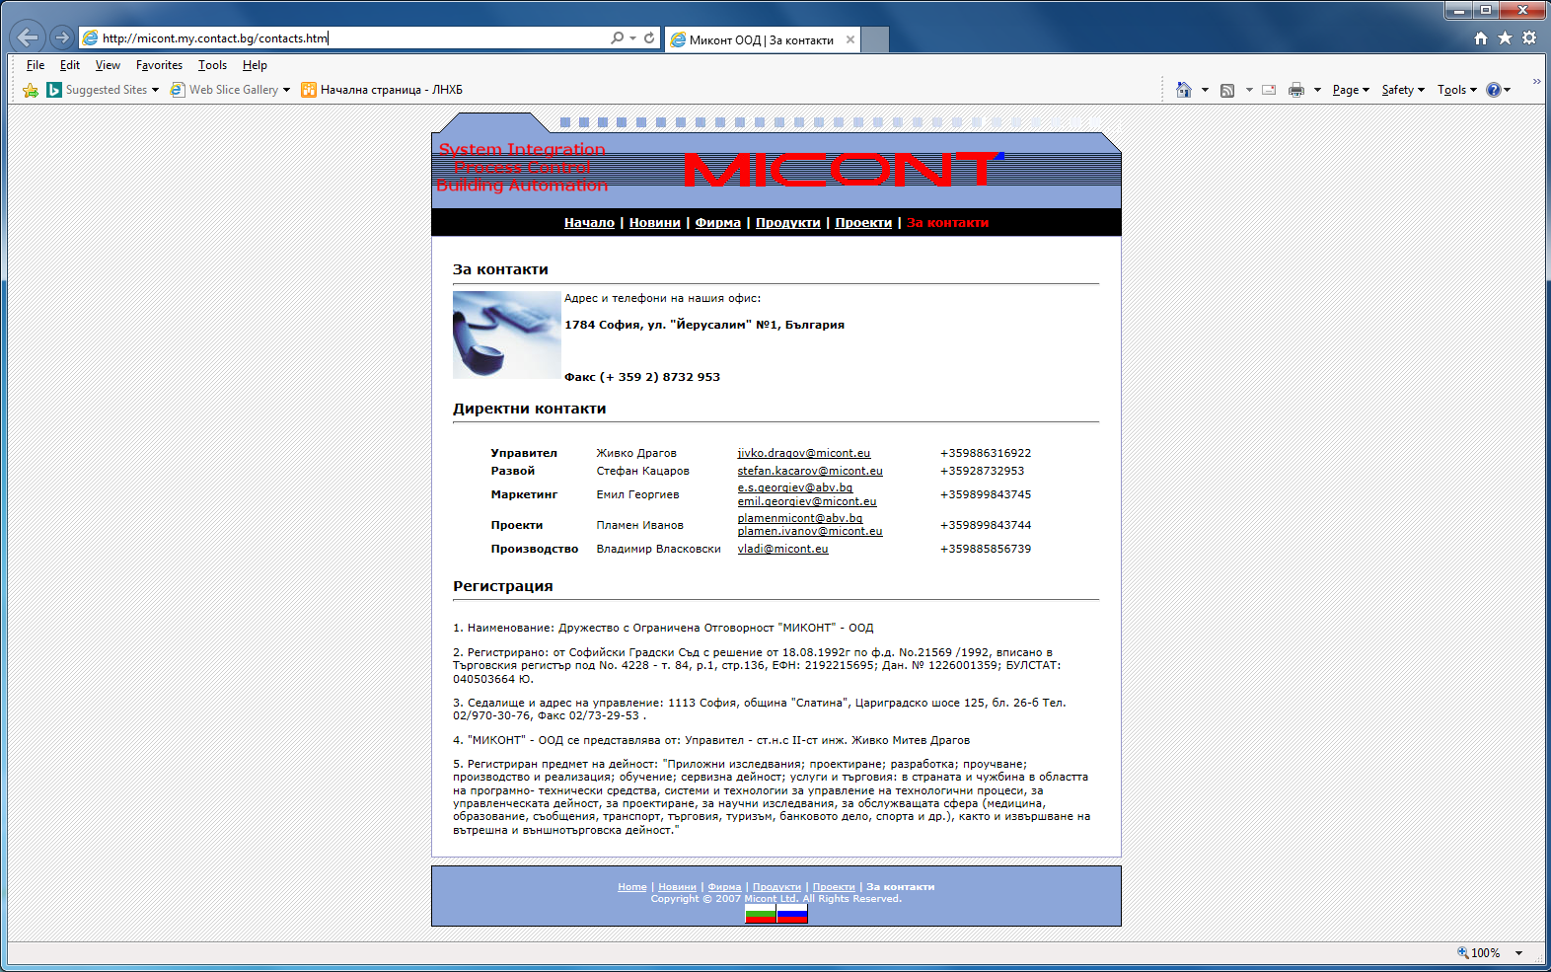
Репрезентативни знаменателни „консерватори“
Българските Borland/Symantec, etc.
Наследник/правоприемник
на бившето ИТКР към БАН
Статичен и тривиален, но
твърде добре работещ и
ефикасен Web-сайт
Класически пример за
B2B Web-сайт
Цялостен, пълноценен
Process Control
Предмета на дейност на Дружеството е:
"Приложни изследвания; проектиране;
разработка; проучване; производство и
реализация; обучение; сервизна дейност;
Услуги и търговия: в страната и чужбина
в областта на програмно- технически
средства, системи и технологии за
управление на технологични процеси,
за управленческата дейност,
за проектиране, за научни изследвания,
за обслужващата сфера (медицина,
образование, съобщения, транспорт,
търговия, туризъм, банковото дело,
спорта и др.), както и извършване на
вътрешна и външнотърговска дейност."

Slide 8

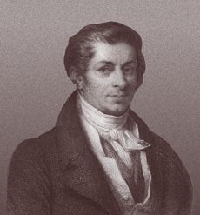

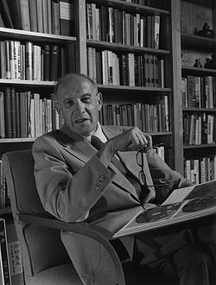
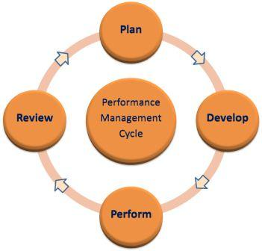
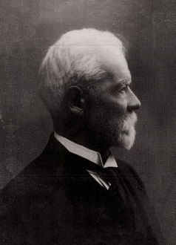
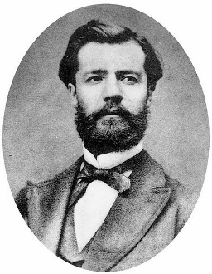

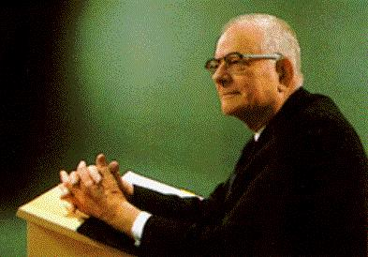
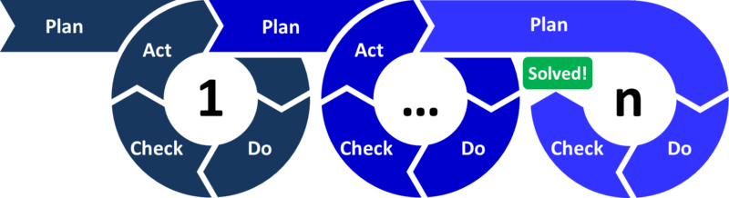
The Motto - Origin & Inspirators
Together we transfer resources
from low-efficiency areas
to high productivity areas.
Jean-Baptiste Say
Peter F. Drucker
Henri Fayol
W. Edwards Deming
Dale Carnegie

Slide 9

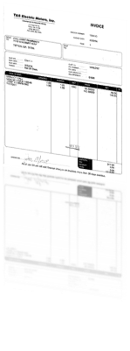
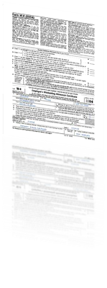
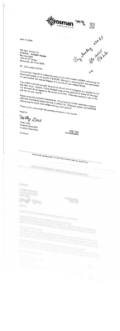
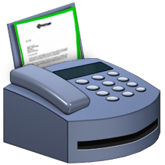




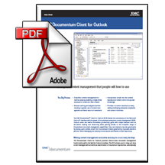

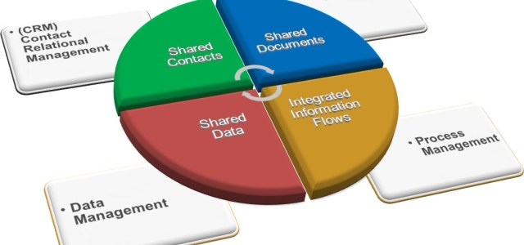
Documentum Documents Management System
Incoming documents
Exit
Finances
Contracts
Correspondence
Documents arriving in the company (snail mail) or electronically (fax/Email)
Outgoing documents
EMC Documentum
Input
Orders
Memorandum
Correspondence
Documents are created and maintained electronically throughout a fax server.
9

Slide 10


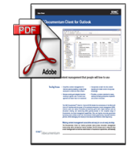
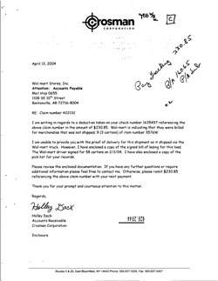






Documentum Documents Management System
Entrance
Registration
form
Scanning
Reg. card
+ image
ЕDocument
Reg. card:
Metadata
Author
Data
Location
Title
Contractor
All hardcopy documents are archived straight after the scanning.
All possible actions with the documents: review, approve, signature and etc., are maintained only electronically.
ARCHIVE
10

Slide 11


Documentum Documents Management System
No hardcopy documents
Organization 1
Organization 2
There should be an agreement between the two organizations for using electronic “no hardcopy documents policy!”
11

Slide 12
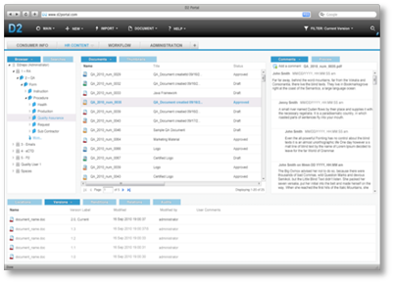
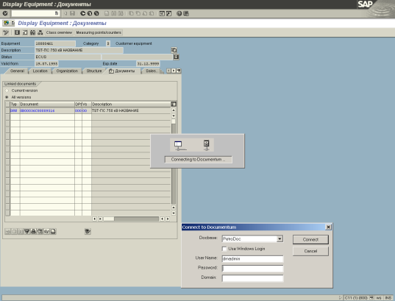
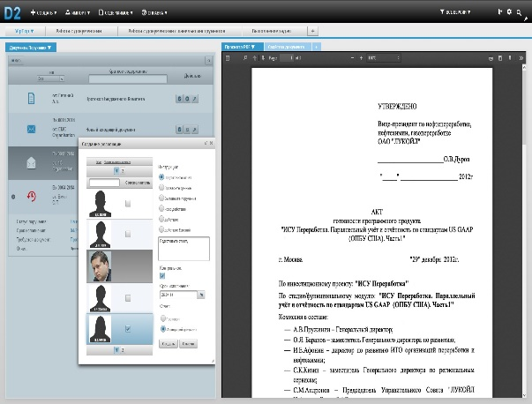
Documentum Documents Management System
Functionalities:
Electronic enterprise archive
Organizational distribution of document flow and correspondence
Financial document flow – sales, delivery, SAP integration
Appraisal and storage of contracts, SAP integration
Other processes for management of corporate documents
12

Slide 13
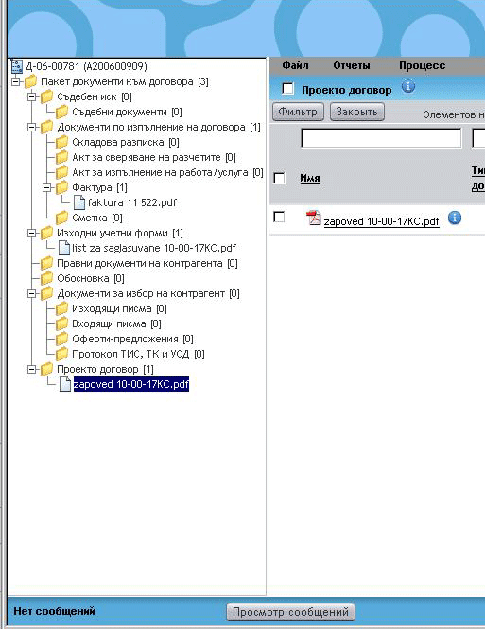
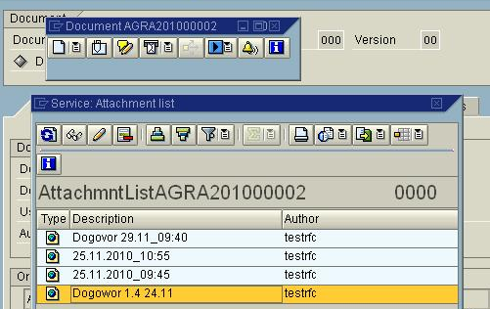
Documentum Documents Management System
There is a full integration with SAP.
The processes are running on both systems.
13

Slide 14
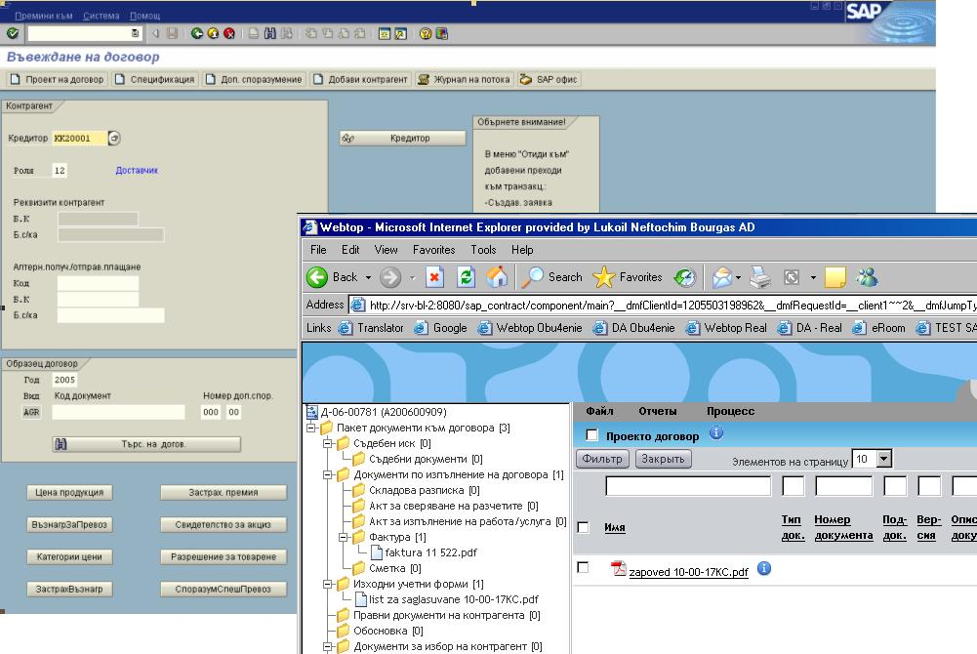
Documentum Documents Management System
Appraisal and storage of contracts – SAP integration
14

Slide 15
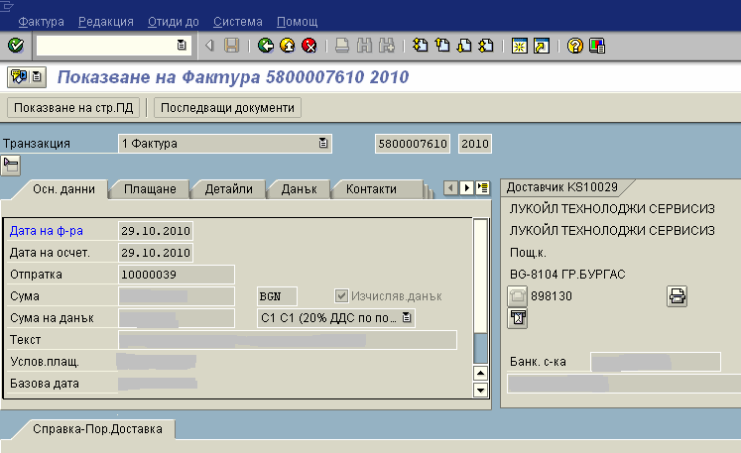
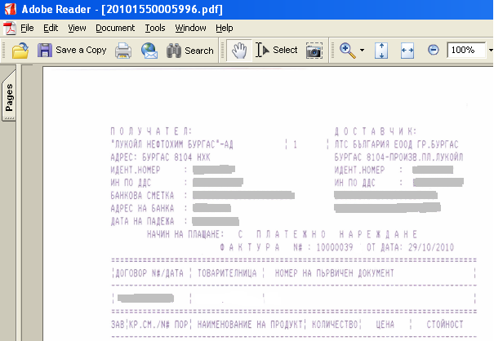
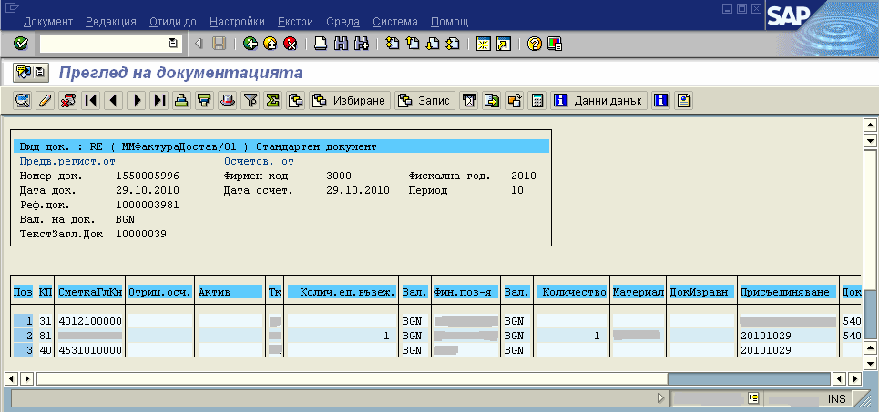
Integration with SAP – Documentum incoming invoices
Documentum Documents Management System
15

Slide 16
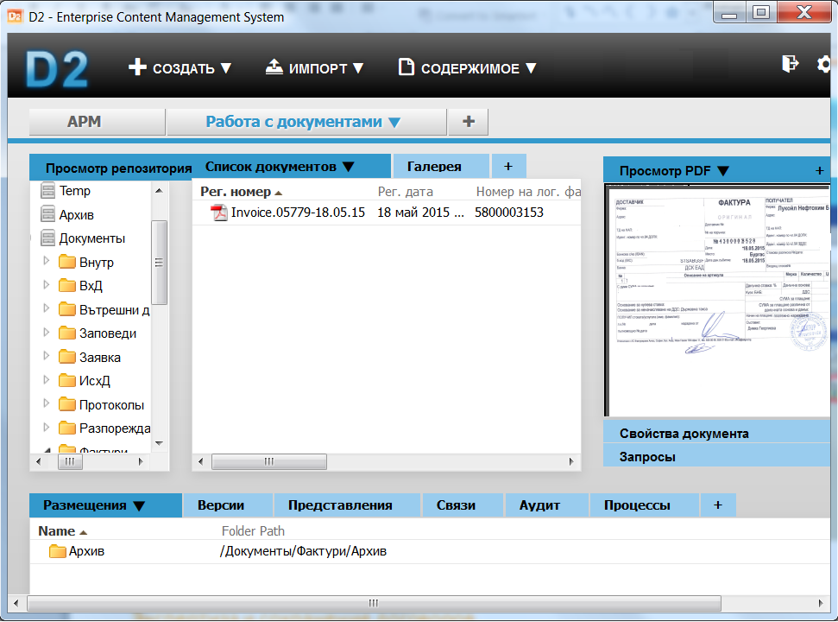
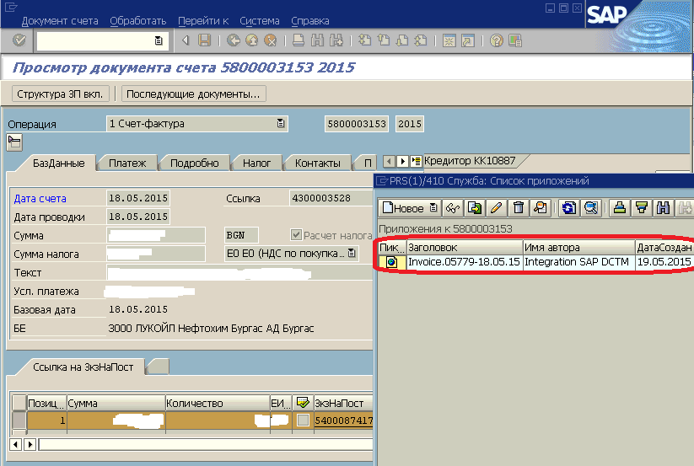
Documentum Documents Management System
Financial document flow for incoming invoices– outsource of accounting functions
Company “X”
Contractor “Y”
Upkeep of standard and tax accounting
Executants in company “X” register the incoming invoices in system Documentum D2.
The funds center supervisors in company “X” agree on the invoices in D2 system.
Integration between the SAP and D2 systems allows for the remote processing of incoming invoices by accountants of company “Y” in the SAP system.
16
16

Slide 17
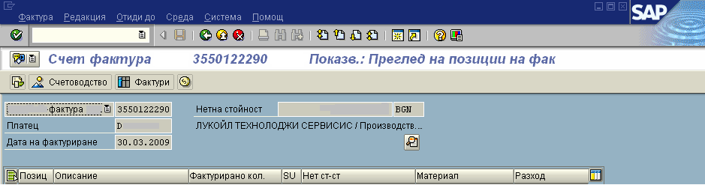
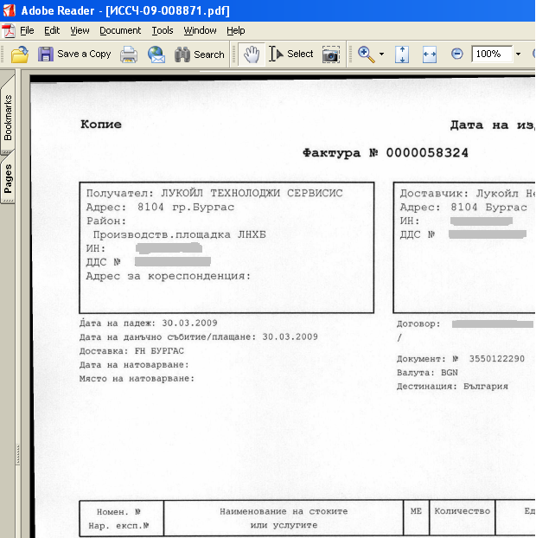
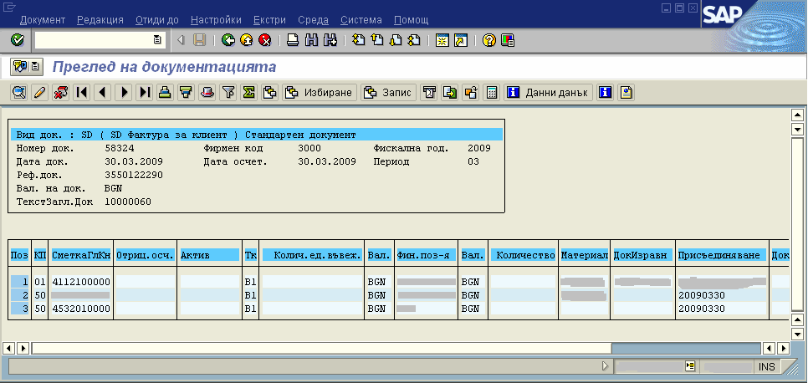
Integration SAP – Documentum outgoing invoices
Documentum Documents Management System
17

Slide 18








EMC DOCUMENTUM OFFERED CLIENTS AND APPLICATIONS
Documentum Documents Management System
MOBILE
DOCUMENTUM MOBILE
FOCUSED CLIENTS
CONFIGURABLE
CLIENTS
ADJUSTABLE/
PROGRAMMABLE
COLLABORATION
PROCESS-CENTRIC
CENTERSTAGE / EROOM
DOCUMENTUM D2
PRODUCT FAMILY
DOCUMENTUM
xCP
DIGITAL ASSET MANGEMENT
MEDIAWORKSPACE
OFFICE INTEGRATION
CONTENT-CENTRIC
MY DOCUMENTUM
WEBTOP
Current version of the platform Documentum 7
DOCUMENTUM PLATFORM
OPTIMIZED FOR THE PRIVATE CLOUD
18

Slide 19

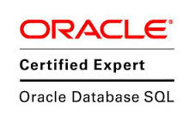



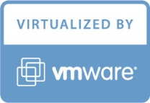

AVAILABLE RESOURCE FOR IMPLEMENTING DOCUMENTUM
Documentum Documents Management System
COMPANY “BUSINESS MANAGEMENT SYSTEMS” HAS HIGHLY QUALIFIED TEAM OF SPECIALISTS WITH EXPIRIENCE IN IMPLEMENTATION AND SUPPORT OF DOCUMENTUM SOLUTIONS.
THE TEAM HAS IMPLEMENTED STANDARD AND SPECIFIC PROJECTS INCLUDING SAP ERP INTEGRATION.
CERTIFIED DOCUMENTUM CONSULTANTS:
2 DEVELOPMENT CONSULTANTS
3 ADMINISTRATION CONSULTANTS
CONSULTANTS BY AREA:
3 CONSULTANTS FOR SUPPORT & ADMINISTRATION
2 CONSULTANTS FOR SOFTWARE ARCHITECTURES
1 CONSULTANT FOR BUSINESS MODELLING
1 CONSULTANT FOR SAP ABAP (INTEGRATION)
2 CONSULTANTS FOR DВ ADMINISTRATION (ОRACLE)
19

Slide 20

Thank you for your attention!
Business Management Systems Ltd.
Business Management Systems Ltd.
Bulgaria Office:
Address: Production Site of Lukoil Neftohim Burgas AD
Post code : 8104 Burgas, Bulgaria
Phone: +359 5511 3337
Fax: +359 898 131
Mail: marina.dimitrova@bmsys.eu

